Slide 1
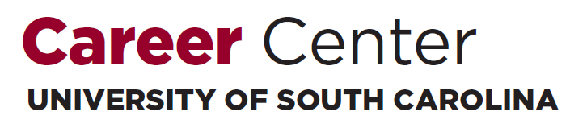
Prepare for the Fair:
Science, Engineering, & Technology Fair
Fall 2017
Lindsey Boggess ▪ Katie Kinniburgh ▪ Chris Lewandowski

Slide 2
Our Mission
The mission of the University of South Carolina Career Center is to educate and empower students in their development of lifelong career management skills.

Slide 3

How does the Career Center help?
Resume Reviews
Major & Career Exploration
Handshake
Internship & Co-op Search
Mock Interviews
Company Research
Salary Negotiation
Professional Development

Slide 4

Pop Quiz!

Slide 5
Today’s college students will have 12 to 15 jobs over the span of their career.

Slide 6
FACT

Slide 7
Employers don’t expect students to have any career-related experience before they graduate.

Slide 8
CRAP

Slide 9
Computing majors who graduated in 2015 reported starting salaries that averaged
$63K.

Slide 10
FACT

Slide 11
Students who participated in an internship/co-op had starting salaries that were $8K higher than their peers.

Slide 12
FACT

Slide 13

xperiential Education
Any type of hands-on experience in which you can apply ideas and theory from the classroom to real world situations. Experiential education also engages students in deliberate reflection through learning objectives.

Slide 14
What does Experiential Education look like?
Experience it.
Internships
Job Shadowing
Research
Student Organizations
Peer Leadership
Volunteerism
Part-Time Work
Study Abroad
Co-ops
Externships

Slide 15
What is a resume?

Slide 16
What is a resume?
Summary of your qualifications
Education
Experiences
Skills

Slide 17
Pop Quiz #2!
What is the initial amount of time an employer takes to review an applicant’s resume?
Answer:
6 seconds minimum
30 seconds maximum
YOUR RESUME | YOU
Neat Organized Error-free | Neat Organized Detail-Oriented

Slide 18
Resume Appearance
Use light colored paper
Keep font-size between 10 and 12 pt
Use common fonts (Times New Roman, Calibri, Cambria, etc.)
If using graphics, keep them simple
Keep margins between 0.5 and 1”

Slide 19
Resume Components
Header (your identifying information)
Objective
Education
Honors
Experience
Related Coursework
Volunteer/Community Service
Skills
Activities
Professional Organizations

Slide 20
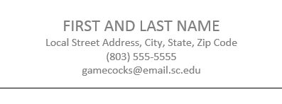
Header
Cap the top of your resume with…
Full name
Your address (home or local)
Phone numbers
Email address
Personal website (if appropriate)

Slide 21
Objective
Optional category that specifies the profession you are seeking
Be specific and concise
Bad Example
A position where I can learn and have hands on opportunities.
Good Example
To obtain a position as a programmer contributing my knowledge of the information systems field.

Slide 22
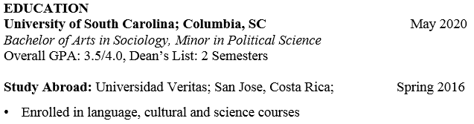
Education
MUST INCLUDE:
Name of the school or university where you earned a degree
City and state in which the school is located
Expected graduate date (Month Year)
Degree (Bachelor of…)
Major, minor, or cognate
GPA if above a 3.0 (cumulative or major)
MAY ALSO INCLUDE:
Awards/Honors/Scholarships (consider a separate section if ≥3)
Dean’s List, President’s List, Scholarship Programs, Honors College, Capstone Scholars
Study abroad experiences
Relevant coursework

Slide 23
Related Coursework
Optional, and can also be incorporated into the “Education” section if preferred
Used when you lack related experience but want to demonstrate specific knowledge
List course titles that relate to the position for which you’re applying
For example:
Algorithmic Design I & II | UNIX/Linux Fundamentals
Digital Logic Design | Introduction to Computer Architecture

Slide 24

Skills
Optional (but valuable!)
Focus on “hard skills”
List product names and
numbers if possible
Possible categories include:
* Students seeking positions in technology should break this list down
Computers | Technology | Language
Programming languages Hardware Software | Operating systems Databases Peripherals

Slide 25
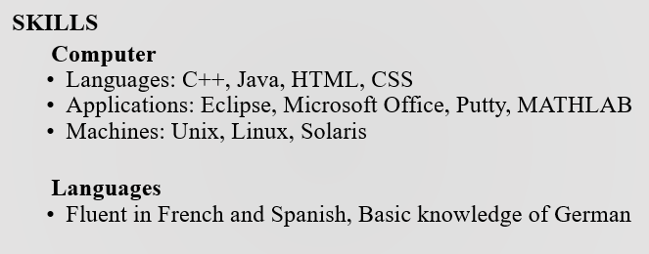

Slide 26
Experience
Can be labeled as…
Always include:
Employer Name
Employer Location (City, State OR School)
Your position title
Dates of employment
Bulleted list of accomplishments/contributions beginning with an ACTION VERB
Work Experience | Relevant Experience | Research Experience | Volunteer Experience

Slide 27
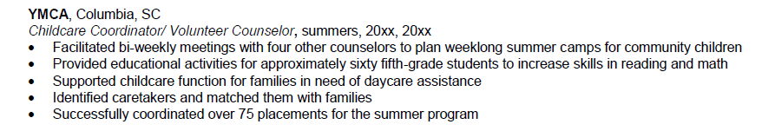
Building Your Bullet Points…
Describe your accomplishments*
Use short, concise sentences
Describe “soft” (transferrable) skills you utilized
Communication
Teamwork
Customer service
Quantify: Use numbers, percentages, dollar amounts

Slide 28
Additional Categories
Honors
Activities
Research
Professional affiliations
Consider including…
Activities/leadership positions that demonstrate job-related skills
Honors or awards

Slide 29
Let’s Review…
Resume DO’s | Resume DON’Ts
Use action verbs | Use pronouns (I, me, my, etc.)
Use concise sentences | Include references
Keep resume to 1 page | Include personal information (age, marital status, gender identity)
PROOFREAD! | Include nonessential information

Slide 30

What is
?
Every job starts with a handshake.
The USC Handshake database allows students to search for jobs, internships, and co-ops.
To activate your account:
- Go to https://sc.joinhandshake.com
- Enter your @mailbox or @email.sc.edu email address, then click U of SC Student Log-In
- On the next screen, type in your network name and university password

Slide 31
Handshake Resume Approval
Approved
Not Approved
Can look at posted positions
Can be searched for by employers
Can apply for any position posted
Can look at posted positions
Can be searched for by employers
Cannot apply for ANYTHING
* To obtain Approved access to Handshake, you will need to upload your resume to your Handshake profile. Please do this early!

Slide 32
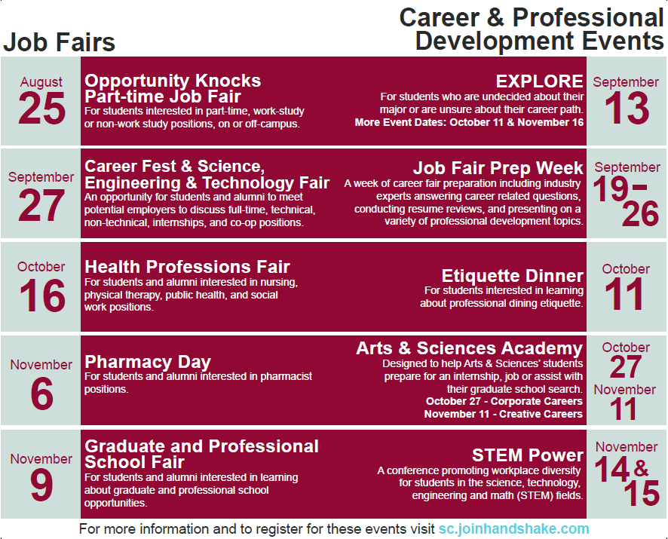

Slide 33


Slide 34
The Importance of Networking
80% of job vacancies are never advertised.
Most employers would prefer to hire a person referred by a colleague, peer, or friend and believe they will be exposed to a higher quality candidate in this manner.
The overall time needed to find a job can be drastically reduced.
4-6 months if networking
6-9 months if not networking
You can learn more about your fields of interest and occupations within it, as well as information about specific organizations.
Notes:
Therefore, it’s important to follow up appropriately!

Slide 35
Know Your Goal
Understand your reason for attending the fair. Are you…
Looking for full-time or part-time jobs, internships, or co-ops?
Exploring career opportunities?
Investigating companies?
Practicing your networking skills?

Slide 36
Researching Employers Attending the Fair
Review the list of employers attending the fair
Handshake
Fairs app
Visit employer web sites
Narrow your focus and prioritize the number of employers you want to connect with

Slide 37

Prepare your Pitch
Elevator Pitch: Marketing message for your professional self
Your qualifications + Your interests/goals = Your Pitch
30-60 seconds
Practice, practice, practice!
Notes:
Articulate who you are, where you’ve been, and where you want to go
*The image is hyperlinked to an elevator pitch video.

Slide 38
Prepare to Make a Good Impression
Have a well-written, critiqued resume (bring 20+ copies)
Practice your elevator pitch until it sounds natural
Develop a list of questions for employers based on your research
Prepare a “Career Fair Employer Log” to use for note-taking during the fair
Notes:
Know how to relate your past work, academic and out-of-class experiences, to the career field.
Prepare a career log in advance to document career fair information (i.e., To whom have you given a resume?, Are they scheduled to return to USC ?, etc.)

Slide 39
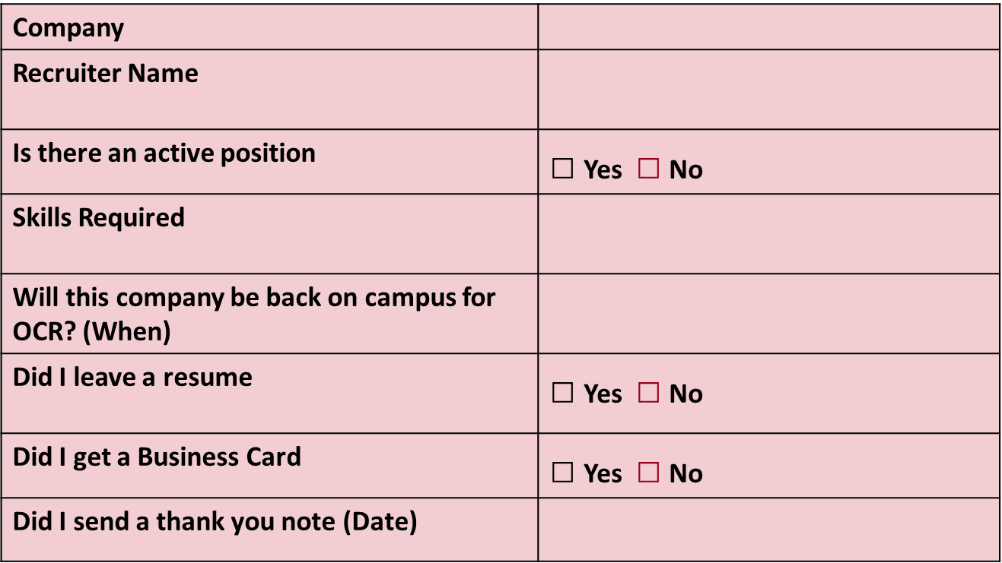
Career Fair Employer Log
Notes:
Know how to relate your past work, academic and out-of-class experiences, to the career field.
Prepare a career log in advance to document career fair information (i.e., To whom have you given a resume?, Are they scheduled to return to USC ?, etc.)

Slide 40

Think Ahead!
Be prepared for potential bad weather
Consider travel time/parking and allow ample time for delays
Talk to professors about class conflicts
Bring 20+ copies of your resume

Slide 41
Make a Good Impression
Arrive early
Behave professionally
Establish rapport with the recruiters
Remember your body language
LISTEN to the recruiter
Don’t ramble
Ask at least TWO intelligent questions of each organization
Notes:
Smile, make eye contact, and shake hands confidently and firmly. Introduce yourself with your full name, major, and graduation date.
Remember your body language…don’t fidget or look around. Act interested, focused, and enthusiastic. Be friendly, assertive, mature, and sincere.
Ask at least 2 intelligent questions of each organization, about such topics as: organizational statistics, company mission, client base, internship or co-op opportunities, summer or part-time employment, full-time career paths, trainee programs, benefits, hiring procedures, etc.

Slide 42
Sample Questions to Ask Employers
What unique factors set this organization apart from others?
What type of entry level positions exist in this field?
How did you get personally interested in this field?
What attracted you to this organization?
What is the typical career path of someone in this organization/field?

Slide 43
Suit Up!

Slide 44
Always Follow Up
Search Handshake/Fairs to determine which employers will be conducting on-campus interviews after the fair
Mail or email thank-you cover letter and resume to selected employers as soon as possible
Follow up with a phone call approximately 2 weeks later

Slide 45

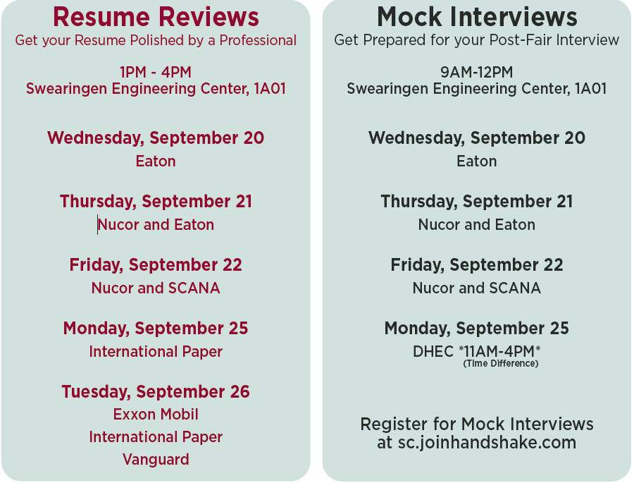

Slide 46


Slide 47
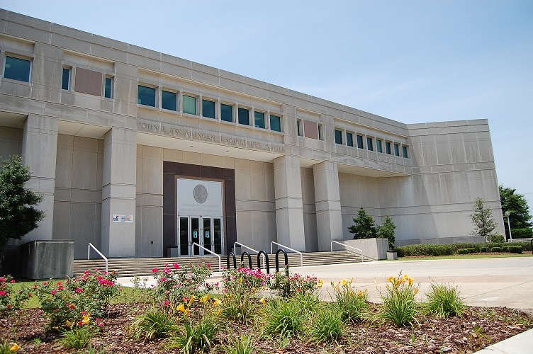
Come visit us!
College of Engineering & Computing Career Center
Swearingen 1A01 | 803-777-1949
Drop-Ins: Monday-Friday, 1-4pm
No appointment necessary!

Slide 48

Thank you!
Questions?

